Slide 1
Versioning in distributed systems

Slide 2
group member： Chen Yuxuan 202221072 Ji Chaoyang 202221076 Jiang yifan 202221073 Ge xuyan 202221063 Jiang zhan 202221058
Module Coordinator Dr Muhammad Aslam

Slide 3
What is Git?
Git is the most advanced distributed version control system in the world.
What are the features of Git? To put it simply: high-end atmosphere and grade!
So what is a version control system?
If you've ever written a long speech in Microsoft Word, you've probably experienced this:
Want to delete a paragraph, and afraid of the future want to recover can not find how to do? There is a way to save the current file as... A new Word file, then change it, change it to a point, then "save it as..." A new file, and so on and so forth, and eventually your Word document looks like this:

Slide 4
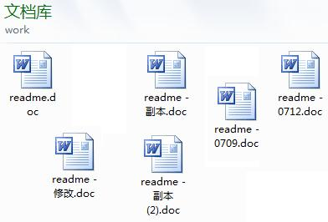

Slide 5
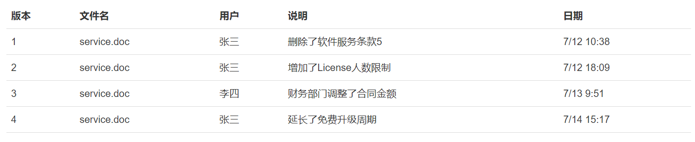
You want to find the deleted text, but can not remember which file was saved before deletion, have to find a file, really troublesome.
Looking at a mess of files, I want to keep the latest one and delete the others, but I'm afraid I'll need them someday
To top it off, your finance colleague needs to help fill out some sections, so you Copy the document onto a USB drive and send it to her (or maybe Email one to her), and then you continue to edit the Word document. A day later, your colleague sends you the Word file again. At this point, you have to think about what changes you made between the time you sent it to her and the time you received her document. You have to merge your changes with her parts.
So you can imagine a software that not only automatically records every change I make to a file, but also allows my colleagues to edit it collaboratively so that I don't have to manage a bunch of similar files myself, and I don't have to pass them around. Wouldn't it be convenient to view a change just by glancing at it in the software?
The software should look something like this, recording every file change:

Slide 6
Last time, we studied versioning in distributed systems and learned the basic usage of GIT.
This time we created a classification neural network system in which git was used to copy and paste files.

Slide 7
Part 1 Code about Git

Slide 8
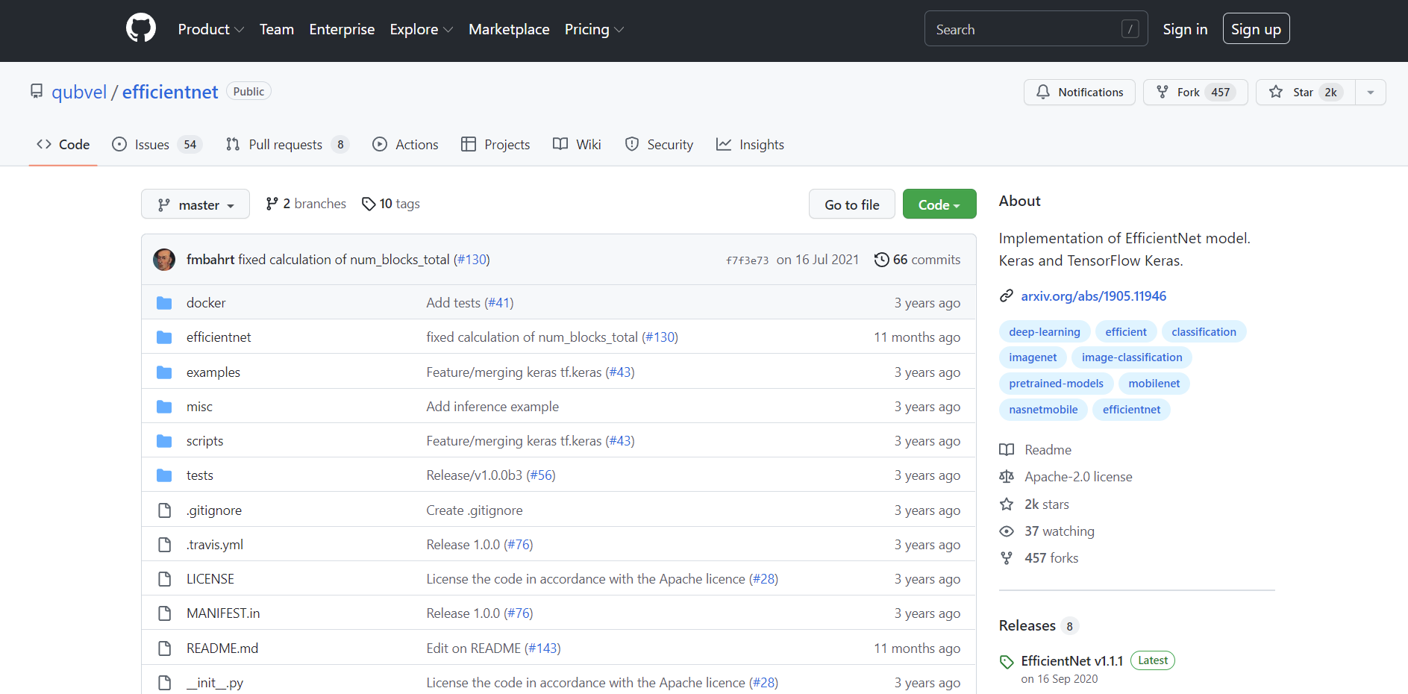
Use git clone to clone from GitHub.

Slide 9
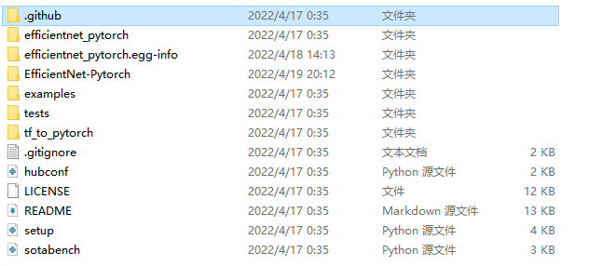
Because the GIT command is used to clone, it exists in the file GitHub file
The submission records in Git warehouse store snapshots of all files in your directory

Slide 10
Our code has three states, modified, staged, and submitted. And their corresponding three areas: working directory, staging area and library The GitHub file is a file generated by synchronizing the information of each region where your code is located when you use the GIT command to clone code from the network.

Slide 11
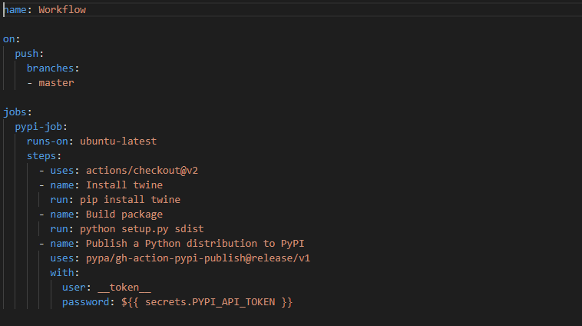
Code

Slide 12
Part 2 conclusion

Slide 13
As a distributed version control system, the concept of master library does not exist in GIT. Each copy of the copied library can be used independently, and any inconsistency between the two libraries can be merged. Git is very fast, which is naturally important for large projects such as the Linux kernel. The best thing about Git is its merge tracing capability.
This time, we used git to upload and download files to the database. During this process, we also encountered many problems, such as unable to upload git warehouse and a series of other problems. But I think this is a very meaningful attempt, which makes us make a lot of progress.

Slide 14
Thaks for watching

